Slide 1
Setting up your environment
Making an AI Application with OpenAI API

Slide 2
Make sure you have Python installed
Installing Python on Mac: https://www.dataquest.io/blog/installing-python-on-mac/
Installing Python on Windows:
https://learn.microsoft.com/en-us/windows/python/beginners
Installing Python on Linux:
https://docs.python-guide.org/starting/install3/linux/

Slide 3
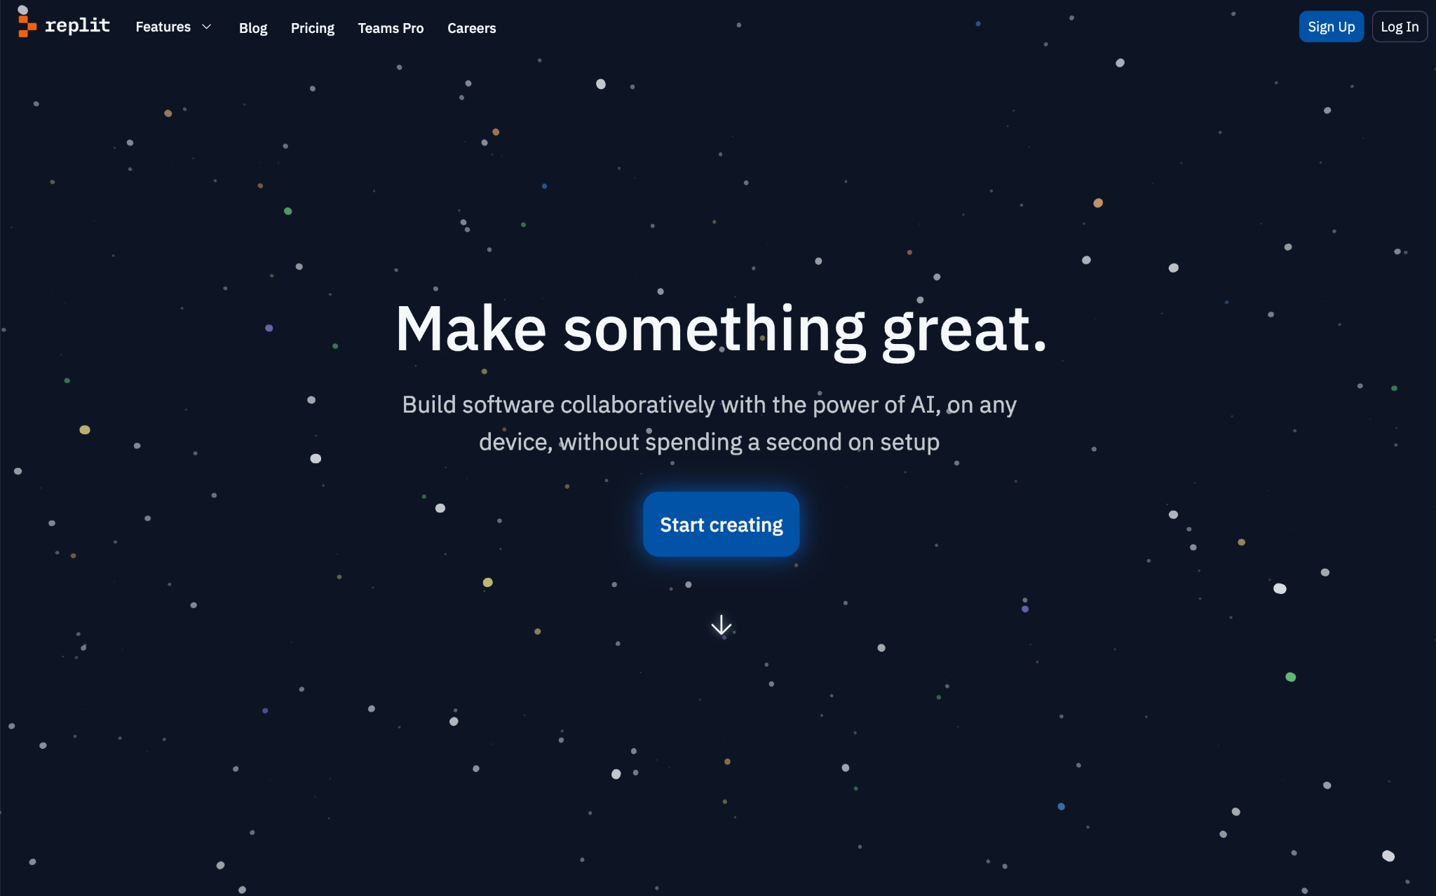
If you don’t want to install Python, use Replit
Go to https://replit.com/
And make an account

Slide 4
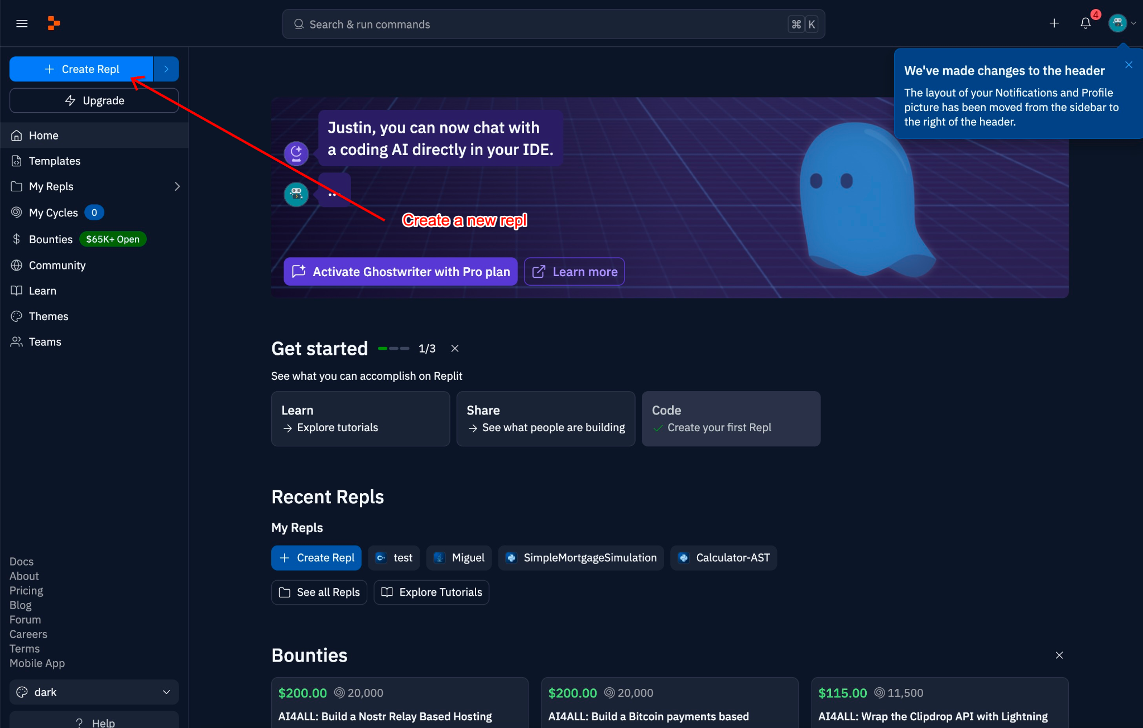
Create a new Repl
Use the button on the top right corner

Slide 5
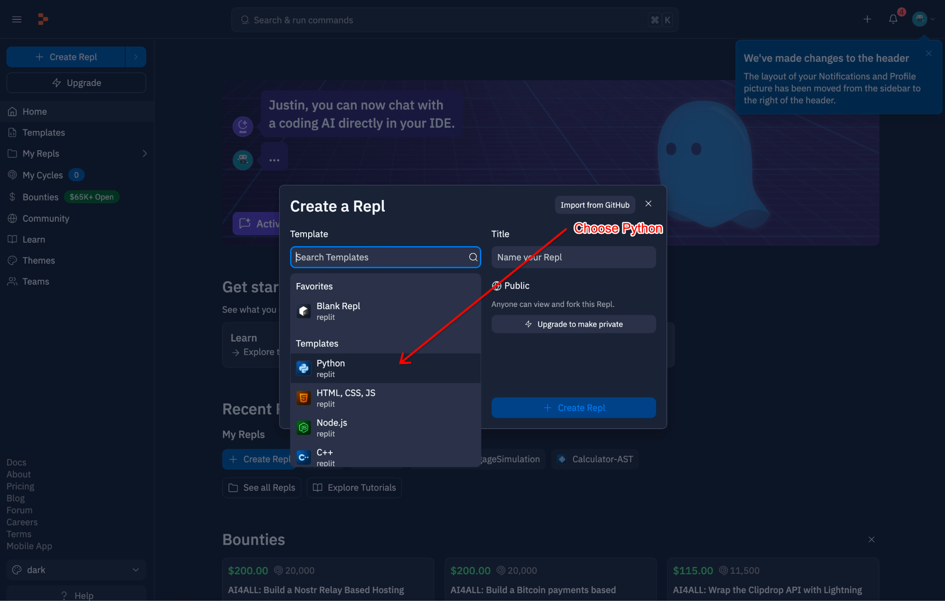
Choose Python from the templates

Slide 6
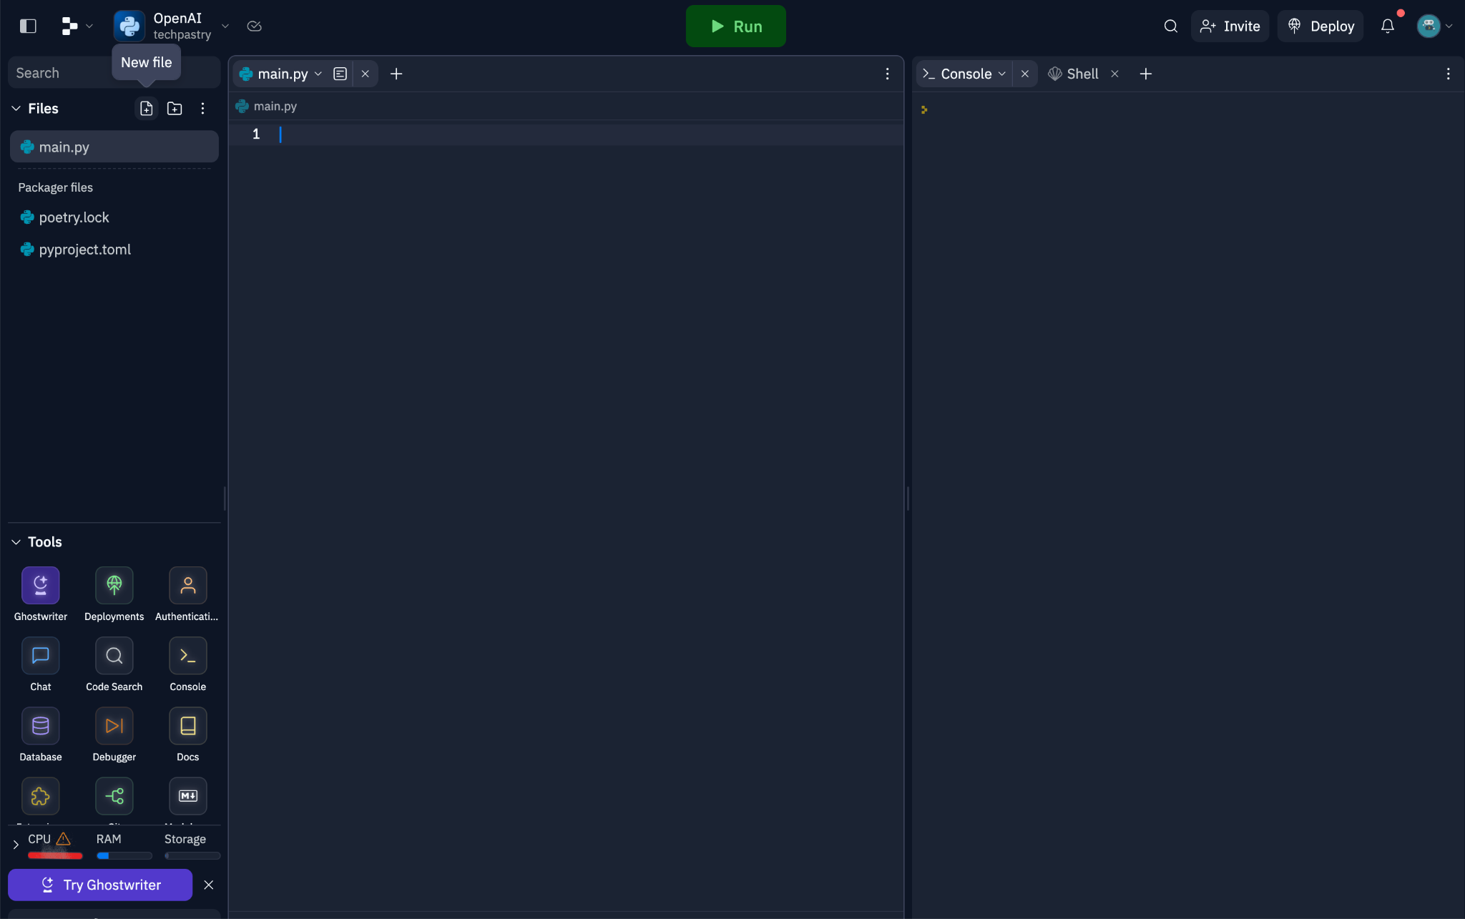
You now have a python environment

Slide 7
Now with Python installed, install the OpenAI Library
In your terminal, install pip3, aka Preferred installation program or the python package manager
All OSes: https://pip.pypa.io/en/stable/installation/
You can install by running the command in your terminal
curl https://bootstrap.pypa.io/get-pip.py | python
If you followed the replit guide, it will already be installed

Slide 8
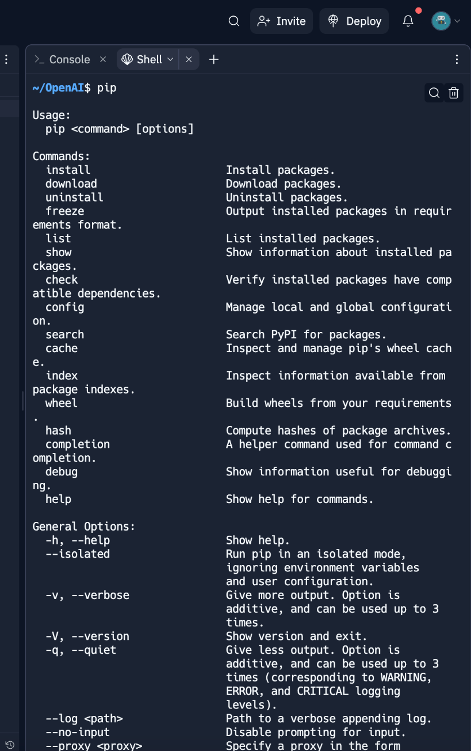
How to test
Go to Shell in replit or your terminal and type, pip. This should appear

Slide 9
Now install the OpenAI Library
In your terminal with pip, run this command
pip install --upgrade openai

